Slide 1
Graph Neural Networks (GNN) Node Classification and Node Embeddings
Theoretical + Practical Implementation on Cora Dataset
Y PAVAN KUMAR

Slide 2
Introduction to Graphs
Many real-world data are graph structured
Graph contains:
Nodes
Edges
Examples:
Social networks
Citation networks
Recommendation systems

Slide 3
Why only GNN
Designed for graph data
Learns from:
Node features
Neighbor relationships
Uses message passing
GNN learns from both node information and graph structure.

Slide 4
Why Not Traditional Neural Networks?
Traditional NN / MLP
Treats nodes independently
Ignores graph connections
GNN
Uses neighbour nodes
Captures relationships
MLP | GNN
isolated learning | relational learning
no graph awareness | graph-aware
lower accuracy | higher accuracy

Slide 5
NODE TECHNIQUES
Node Classification
Node Embeddings
Goal:
predict label/class of nodes
Uses:
node features
graph structure
Examples
paper topic prediction
fraud detection
recommendation systems
Importance
better classification
better clustering
representation learning
Convert nodes into vectors
Similar nodes → similar embeddings
Preserve graph structure

Slide 6
Node2Vec
Learns embeddings using random walks
Captures graph structure
Structure-based learning
Node2Vec uses graph relationships but not node features directly.

Slide 7
Node2Vec vs Node2Vec + Raw Features
Only Node2Vec
Node2Vec + Raw Features of node
structure only
graph position
no feature usage
structure + semantics
graph + node meaning
uses node features

Slide 8
GNN Architectures
GCN: Graph Convolutional Network
Equal neighbour aggregation
Smooth embeddings
Good balance of speed + accuracy
GAT: Graph Attention Network
Uses attention mechanism
Important neighbours contribute more
Better class separation
Not all neighbors are equally important.

Slide 9
GNN Architectures
GIN: Graph Isomorphism Network
Structure-preserving aggregation
Strong expressive power
Captures exact graph structure
GraphSAGE
Samples neighbours
Scalable for huge graphs
Industry-friendly architecture
Suitable for large-scale real-world systems.

Slide 10
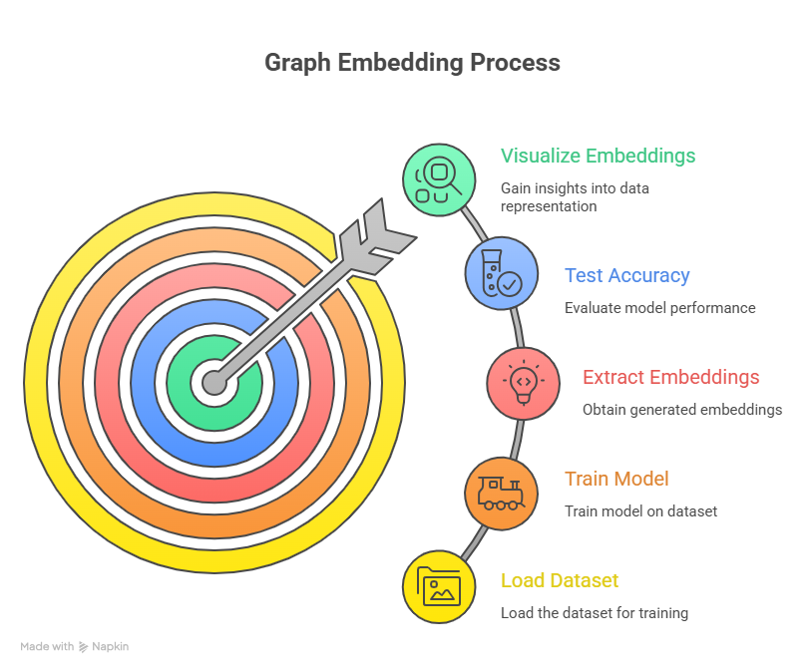

Slide 11
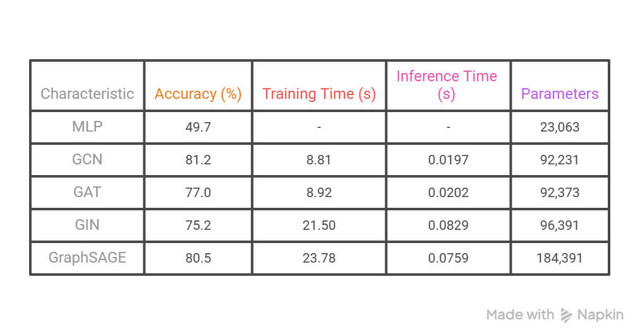
Experimental Results -- CORA Dataset

Slide 12
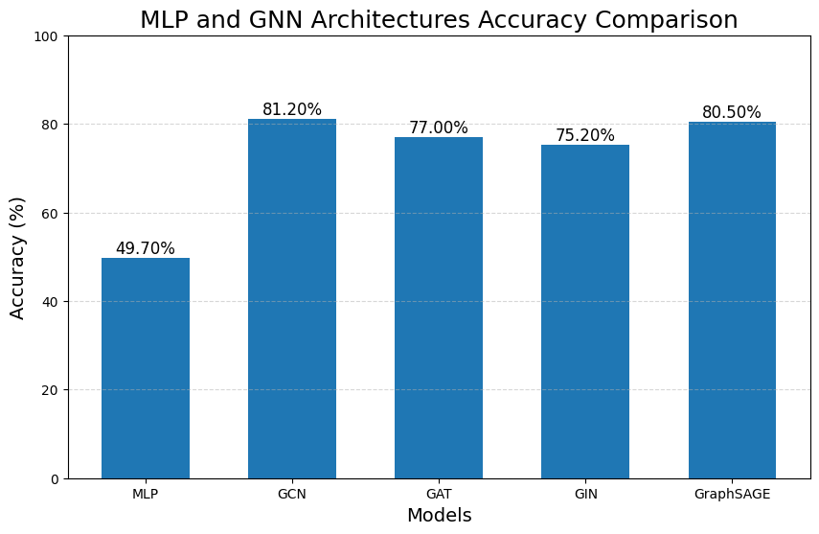

Slide 13
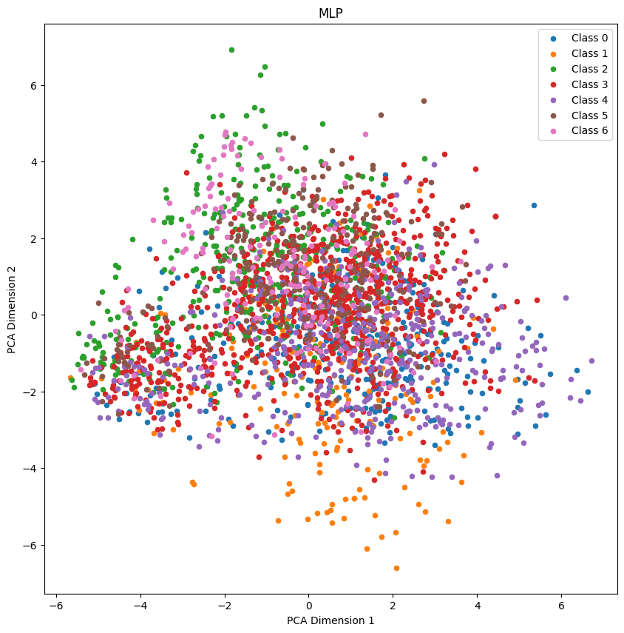
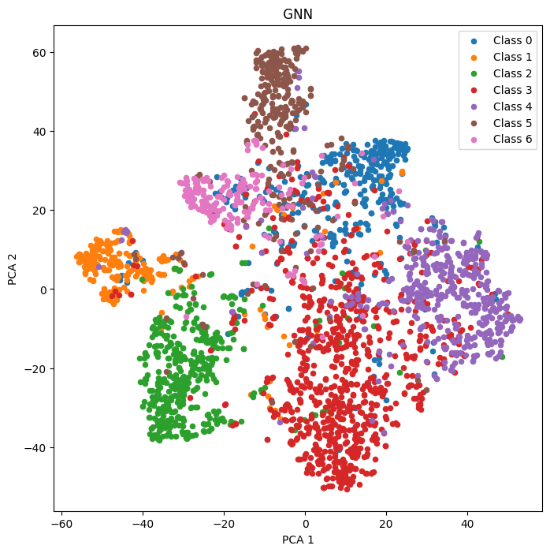
MLP vs GNN
MLP
GNN

Slide 14
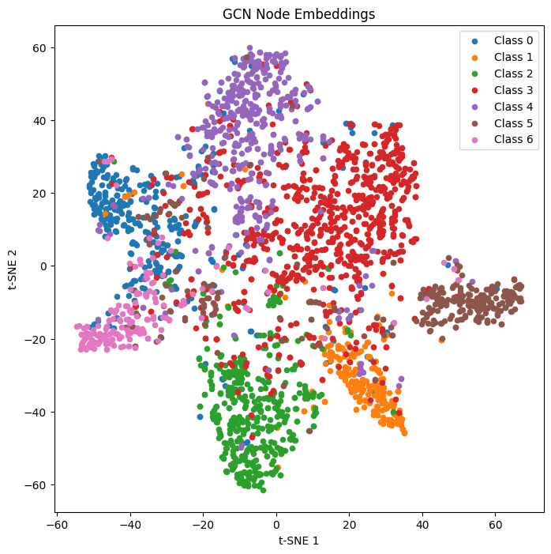
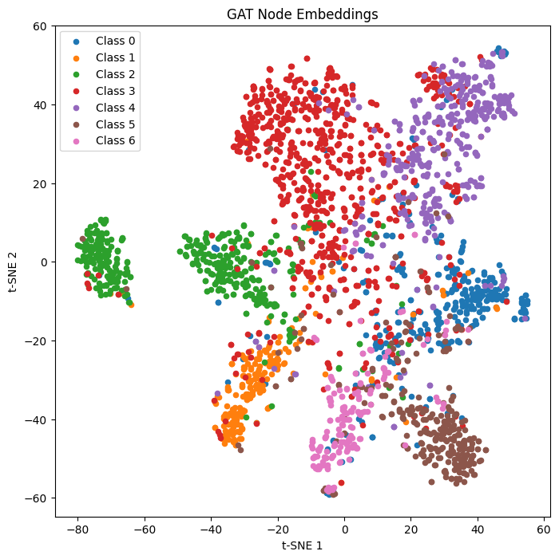
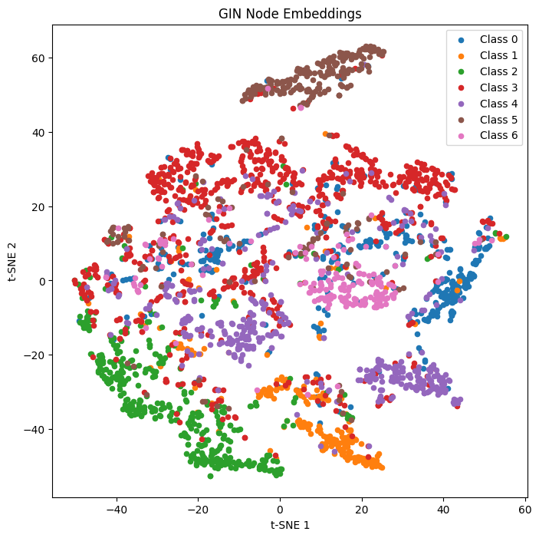
Embedding Visualization

Slide 15
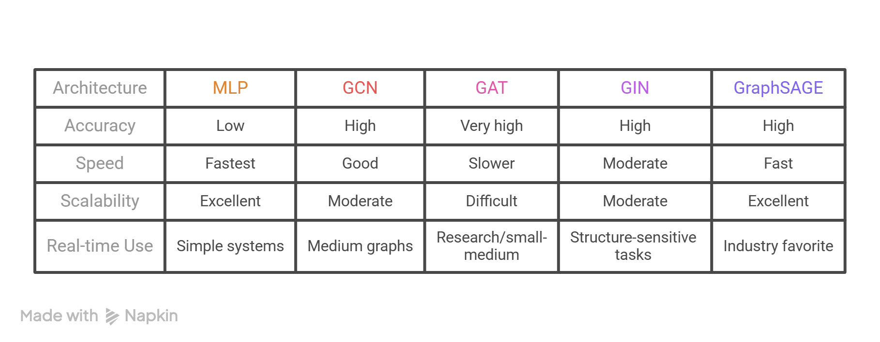
Real Time Scenario's

Slide 16
Conclusion
GNNs outperform traditional NNs on graph data
Graph structure improves Node classification
Node embeddings improve representation learning
Different GNNs have different strengths
GraphSAGE useful for scalable systems
Using graph structure improves Node classification performance.

Slide 17


